Slide 1
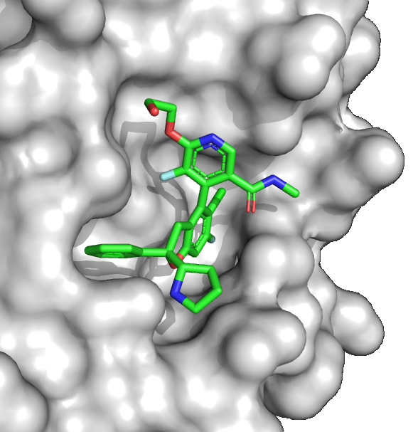
Novartis IAG933_Assignment
The medchem story for this molecule has been published – please read the two papers
doi.org/10.1002/cmdc.202200303
doi.org/10.1002/cmdc.202300051
You can work in pairs. 2-3 pages (text and schemes). Hand in via Moodle. Due date: 28th November
There are multiple synthesis challenges with this molecule. A high-level assessment of the challenges is shown on the next slide
For each of the challenges, outline how technology could be used to overcome the problem paying particular attention to the order by which you would apply the technologies and whether they will be more sustainable
Grades will be given for creativity rather than whether the suggestion is completely viable
English only

Slide 2
Poly-substituted aromatics
Sterically hindered coupling
Atropisomers
Chiral amine
Chiral quaternary centre

